Slide 1
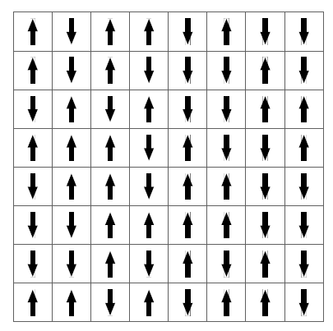
Simulating the 2D Ising model of ferromagnets
Max Dürr

Slide 2
Introduction
The Ising model is a mathematical model for studying magnetism. It focuses on spins on a lattice interacting with neighbors.
The Ising model is a simple and powerful tool to explore phase transitions (transition between an ordered and a disordered state) and thermodynamic properties.

Slide 3
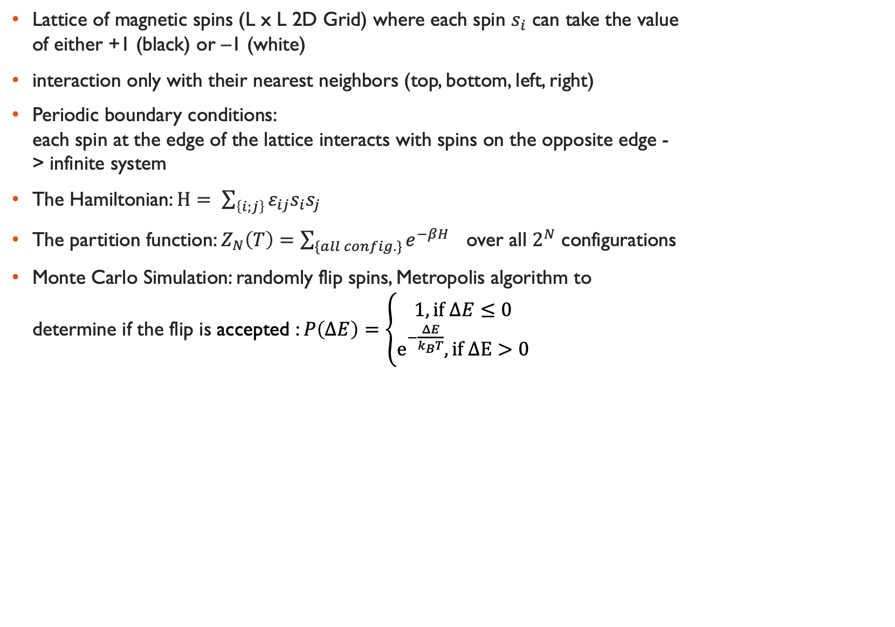
Simulation setup
Lattice of magnetic spins (L x L 2D Grid) where each spin $s_{i}$ can take the value of either +1 (black) or –1 (white)
interaction only with their nearest neighbors (top, bottom, left, right)
Periodic boundary conditions: each spin at the edge of the lattice interacts with spins on the opposite edge -> infinite system
The Hamiltonian: $H= \sum_{\left\{i;j\right\}}{ε_{ij}s_{i}s_{j}}$
The partition function: $Z_{N}\left(T\right)=\sum_{\{all config.\}}{ⅇ^{−βH}}$ over all $2^{N}$ configurations
Monte Carlo Simulation: randomly flip spins, Metropolis algorithm to determine if the flip is accepted : $P\left(ΔE\right)=\left\{\begin{matrix}1, if ΔE≤0 \\ ⅇ^{−\frac{ΔE}{k_{B}T}},if ΔE>0\end{matrix}\right.$

Slide 4
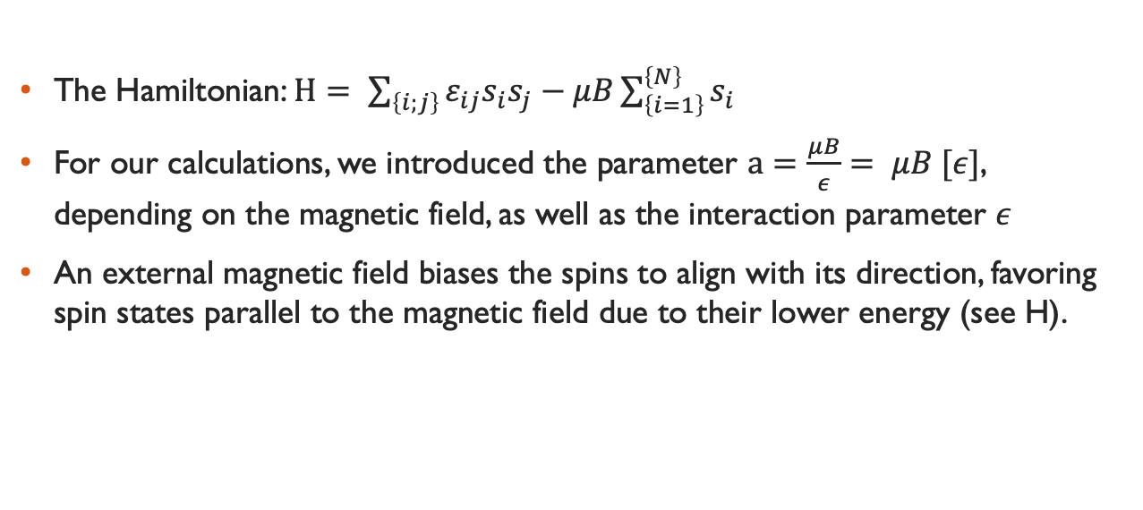
Additional: Magnetic field
The Hamiltonian: $H= \sum_{\left\{i;j\right\}}{ε_{ij}s_{i}s_{j}}−μB\sum_{\left\{i=1\right\}}^{\left\{N\right\}}{s_{i}}$
For our calculations, we introduced the parameter $a=\frac{μB}{ε}= μB [ε]$, depending on the magnetic field, as well as the interaction parameter $ε$
An external magnetic field biases the spins to align with its direction, favoring spin states parallel to the magnetic field due to their lower energy (see H).

Slide 5
Code

Slide 6
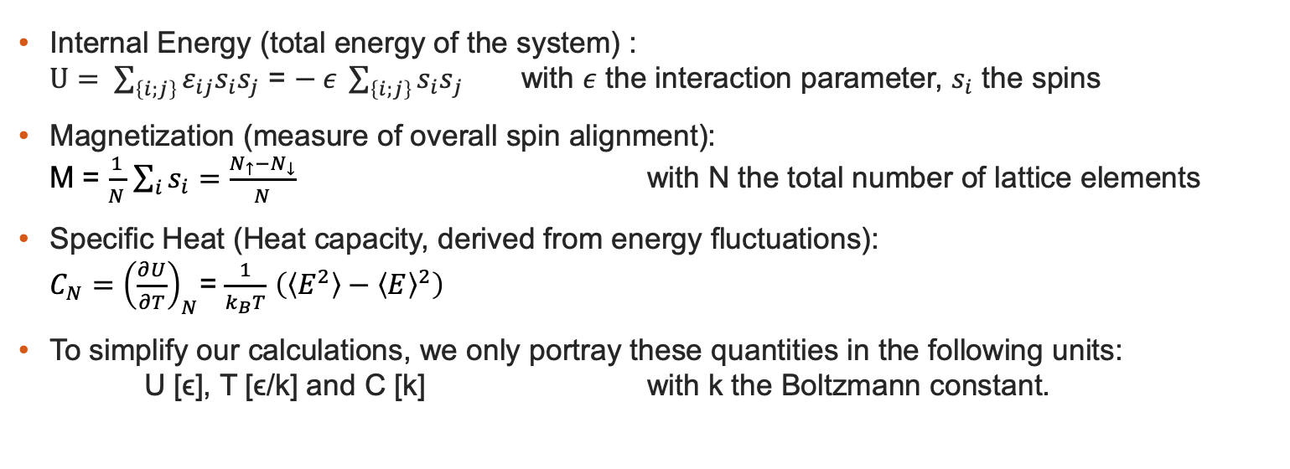
Important quantities
Internal Energy (total energy of the system) : $U= \sum_{\left\{i;j\right\}}{ε_{ij}s_{i}s_{j}}$ = $− ε \sum_{\left\{i;j\right\}}{{s_{i}s}_{j}}$ with $ε$ the interaction parameter, $s_{i}$ the spins
Magnetization (measure of overall spin alignment): M = $\frac{1}{N}$ $\sum_{i}{s_{i}}=\frac{N_{↑}−N_{↓}}{N}$ with N the total number of lattice elements
Specific Heat (Heat capacity, derived from energy fluctuations): ${C_{N}=\left(\frac{∂U}{∂T}\right)}_{N}$= $\frac{1}{k_{B}T}$ $\left(\left\langle E^{2}\right\rangle −{\left\langle E\right\rangle }^{2}\right)$
To simplify our calculations, we only portray these quantities in the following units: U [ϵ], T [ϵ/k] and C [k] with k the Boltzmann constant.

Slide 7
Equilibration process
Internal energy and magnetization settle into steady values after a certain number of Monte Carlo steps
fluctuations become small and consistent
equilibration time depends on temperature and lattice size
initial random configurations take time to reach a thermalized state

Slide 8
Dependancy on temperature

Slide 9
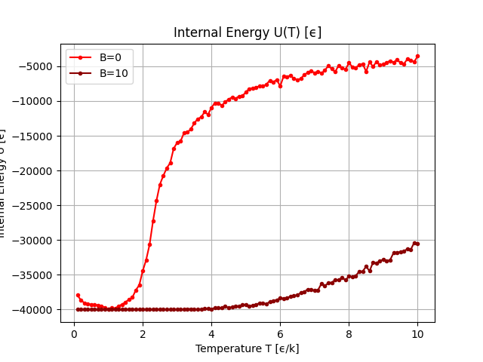
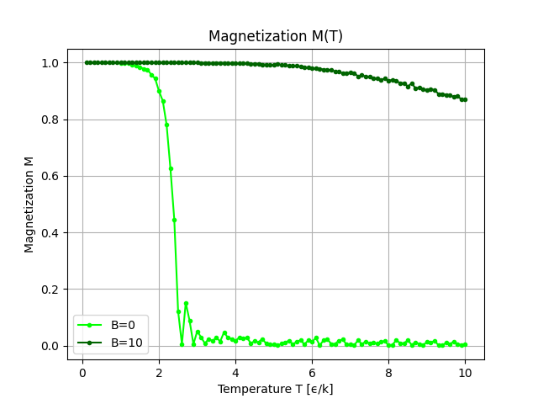
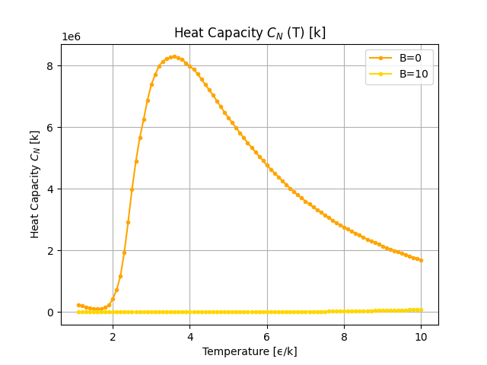
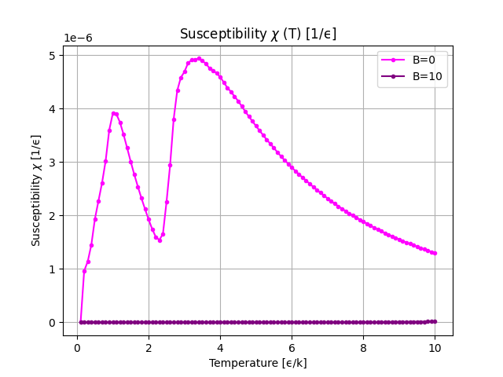
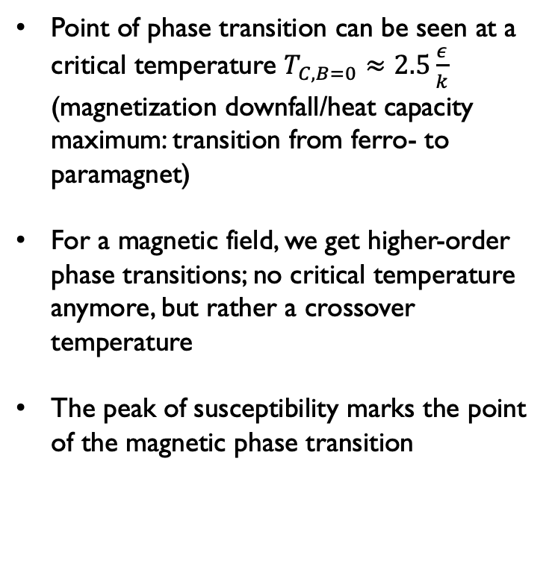
dependancy on temperature
Point of phase transition can be seen at a critical temperature $T_{C,B=0}≈2.5\frac{ε}{k}$ (magnetization downfall/heat capacity maximum: transition from ferro- to paramagnet)
For a magnetic field, we get higher-order phase transitions; no critical temperature anymore, but rather a crossover temperature
The peak of susceptibility marks the point of the magnetic phase transition

Slide 10
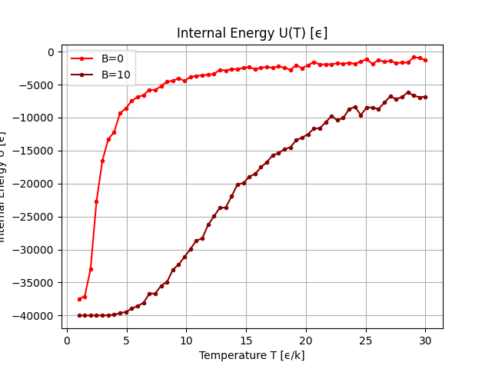
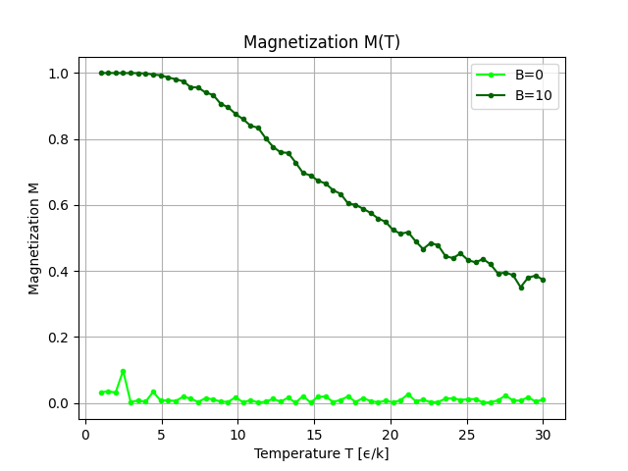
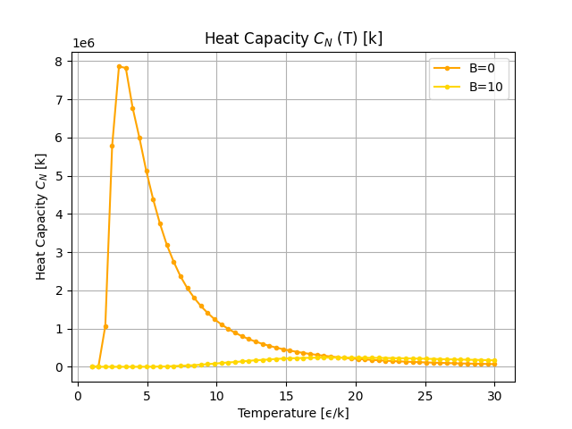
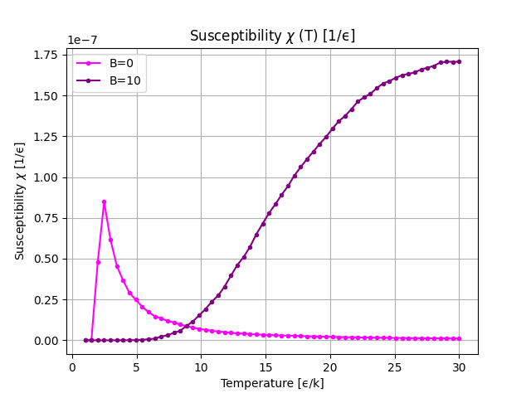
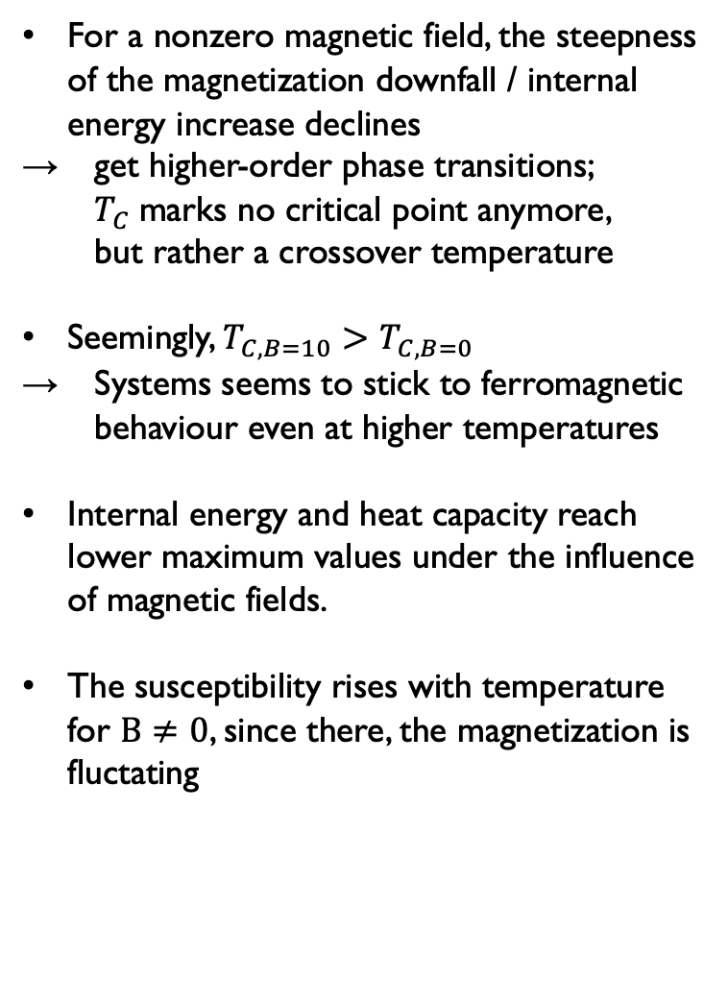
dependancy on temperature
For a nonzero magnetic field, the steepness of the magnetization downfall / internal energy increase declines
→ get higher-order phase transitions;
$T_{C}$marks no critical point anymore, but rather a crossover temperature
Seemingly, $T_{C,B=10}>T_{C,B=0}$
→ Systems seems to stick to ferromagnetic behaviour even at higher temperatures
Internal energy and heat capacity reach lower maximum values under the influence of magnetic fields.
The susceptibility rises with temperature for $B≠0$, since there, the magnetization is fluctating

Slide 11
Simulation at different temperatures
L=100, T=1:
L=100, T=5:

Slide 12
Dependancy on temperature: Conclusion

Slide 13
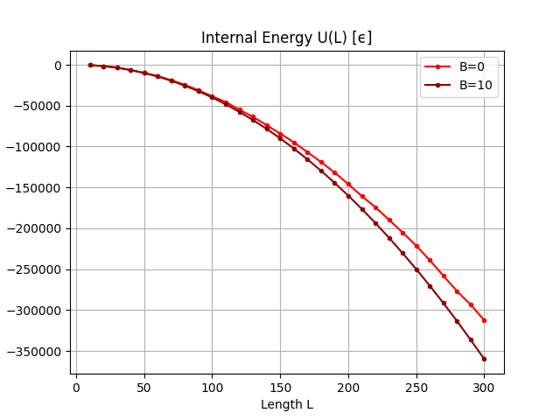
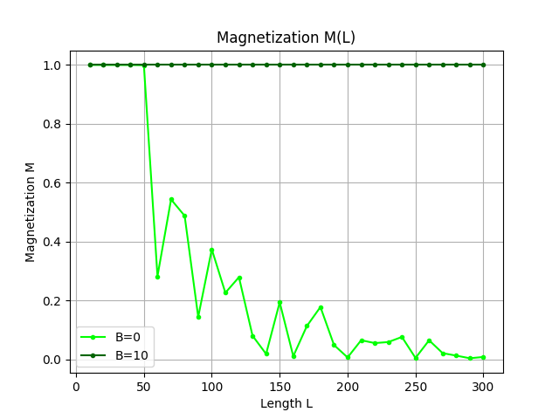
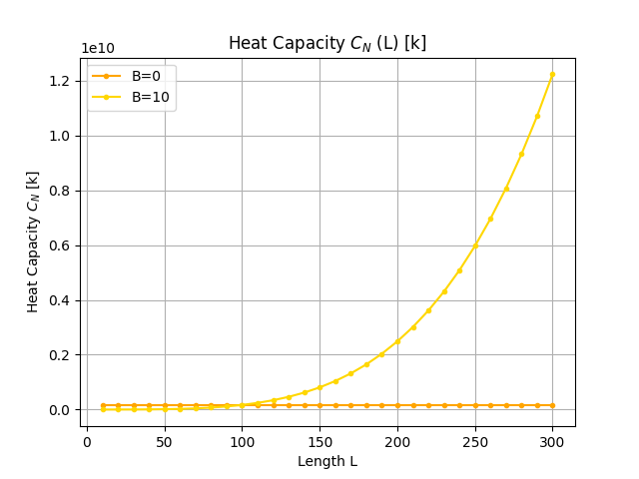
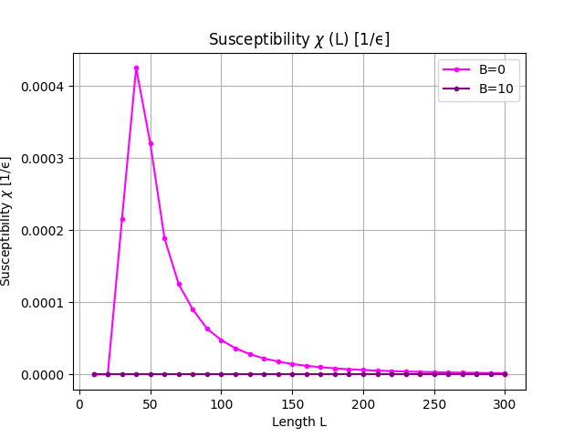
dependancy on lattice size

Slide 14
dependancy on lattice size

Slide 15
Simulation for different Lattice sizes
L=100, T=1:
L=200, T=1:

Slide 16
Dependancy on Lattice size: Conclusion

Slide 17
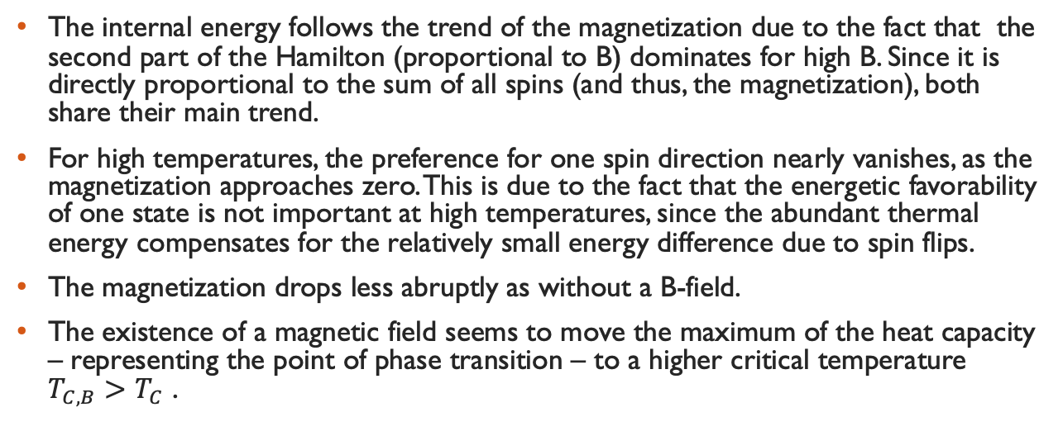
Influence of the magnetic field: Conclusion
The internal energy follows the trend of the magnetization due to the fact that the second part of the Hamilton (proportional to B) dominates for high B. Since it is directly proportional to the sum of all spins (and thus, the magnetization), both share their main trend.
For high temperatures, the preference for one spin direction nearly vanishes, as the magnetization approaches zero. This is due to the fact that the energetic favorability of one state is not important at high temperatures, since the abundant thermal energy compensates for the relatively small energy difference due to spin flips.
The magnetization drops less abruptly as without a B-field.
The existence of a magnetic field seems to move the maximum of the heat capacity – representing the point of phase transition – to a higher critical temperature $T_{C,B}>T_{C}$​ .

Slide 18
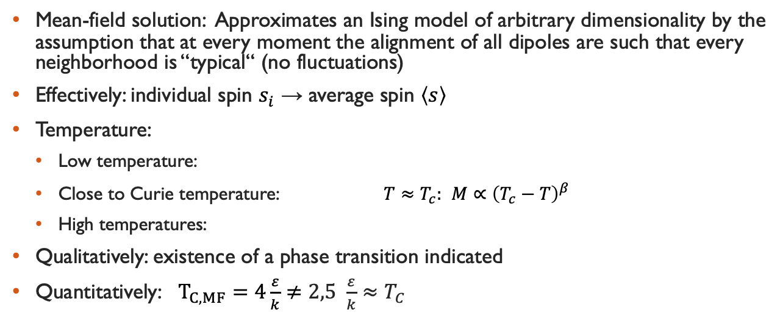
Comparison to the mean-Field-Approximation
Mean-field solution: Approximates an Ising model of arbitrary dimensionality by the assumption that at every moment the alignment of all dipoles are such that every neighborhood is “typical“ (no fluctuations)
Effectively: individual spin $s_{i}$ → average spin $\left\langle s\right\rangle$
Temperature:
Low temperature:
Close to Curie temperature: ${T≈T}_{c}:$ $M∝{\left(T_{c}−T\right)}^{β}$
High temperatures:
Qualitatively: existence of a phase transition indicated
Quantitatively: $T_{C,MF}=4\frac{ε}{k}≠2,5 \frac{ε}{k}≈T_{C}$

